Slide 1
威胁情报论坛

Slide 2
X-Force Exchange
The Concrete Value
of Threat Intelligence Sharing
and IBM X-Force Practice
Ron Williams, STSM
Chief Architect, Infrastructure Security
IBM Security
Ron Williams, STSM, Principal Architect
IBM

Slide 3
Agenda
Threat Analyst Operations - ‘Getting to Go’
The Power of Community
Analyzing, Mitigating, and Sharing Active Threats

Slide 4
The Internet is Really – REALLY BIG
4.2 Billion IPv4 Addresses (Research indicates visibility to ~1.2 Billion < 25%)
7x1038 IPv6 Addresses
Systematic Scanning & Site Analysis is mathematically infeasible.
Effective Internet Threat Data starts with observables associated with questionable activity.
Effective Internet Threat Intelligence starts with intranet observables correlated with Internet Threat Data.
IBM Daily Analyzes 12+ Million Malicious Emails, 10+ Million Web Sites, Generating and updating new threat data across ~1 Billion IPs & URLs

Slide 5
Effective Threat Intelligence
Starts with a trigger (observable)
Malicious Mail (SPAM) -> Dropper URLs, Associated IP’s, Actual Malware
Detected Malware Beaconing to Unknown IP
Network Observable (Suspicious Destination Address)
Further Analysis
IP/URL – Have other’s seen malicious activity? Multi-hoster? New Domain?
Has malware been found? Has it’s C2 infrastructure been identified
Can other’s confirm the ‘Three-Legged Stool: IP, URL, Malware’

Slide 6
Of Observables and Indicators
Q: When does an ‘observable’ become an ‘indicator’

Slide 7
Of Observables and Indicators
A: When it’s associated with other known malicious observables

Slide 8
Collecting the data – making the correlation
True 0-Days may be confirmed in one of two-ways
Human Analysis
Automated Behavioral analysis of one or more of the observables (IP, URL, Malware, Compromised System)
The ‘holy grail’ of Threat Mitigation is ‘Automated Action’ based on ‘Actionable Intelligence’
We have technical examples of this today in Next Generation Firewalls, Intrusion Prevention Systems, Malware Sandboxes, Security Information and Event Management Systems.
But there is yet to be an end-to-end and automated system that can start with a zero-day threat and end with automated and actionable threat intelligence.

Slide 9
Getting to ‘go’ – the role of the threat analyst
Until a Watson or Hal takes over the internet – The Human Security Analyst remains the most important part of any Threat Protection System. His or her role is to:
Understand a threat and how to mitigate it
Apply business metrics to prioritize threat mitigation
And Increasingly – how to apply tools to continuously shorten the time from identification to validation to prioritization to mitigation (or risk acceptance)

Slide 10

Analyst’s
Scope:
Detection/Response
Actors
Techniques, Tactics, Procedures
Indicators
Vulnerabilities
Internet
Threat
Activity
Intranet
Topology
Active Threat Analysis
Use Cases
Prevention
Detection
Response

Slide 11
infiltrating an enterprise (darkhotel)
At hotel, I want WiFi access in Lobby
Presented with ‘Hotel’s’ WiFi Finder App and promise of Free WiFi
Select ‘Connect’ - authenticate to O/S to permit installation
Powned
Urgent phone call - close laptop - leave town

Slide 12
back home in SOC
SIEM Alert - SRC 172.10.34.17 DEST 216.158.85.49
Identified C2 Communications
Response
Identify SRC Machine from Asset Repository/Network
Institute Malware Scan
Found Suspicious File MD5: 560d68c31980c26d2adab7406b61c651

Slide 13
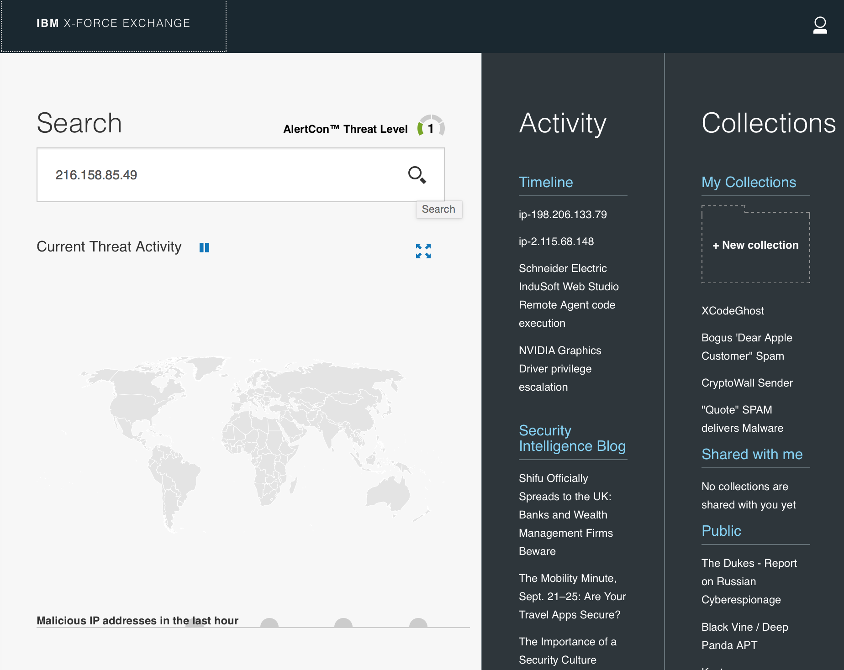

Slide 14
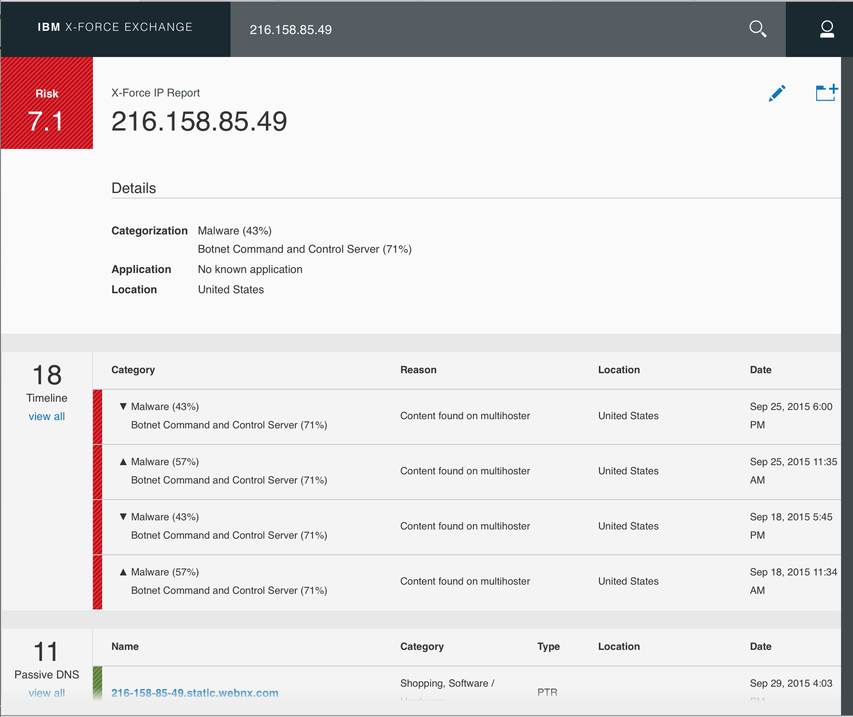

Slide 15
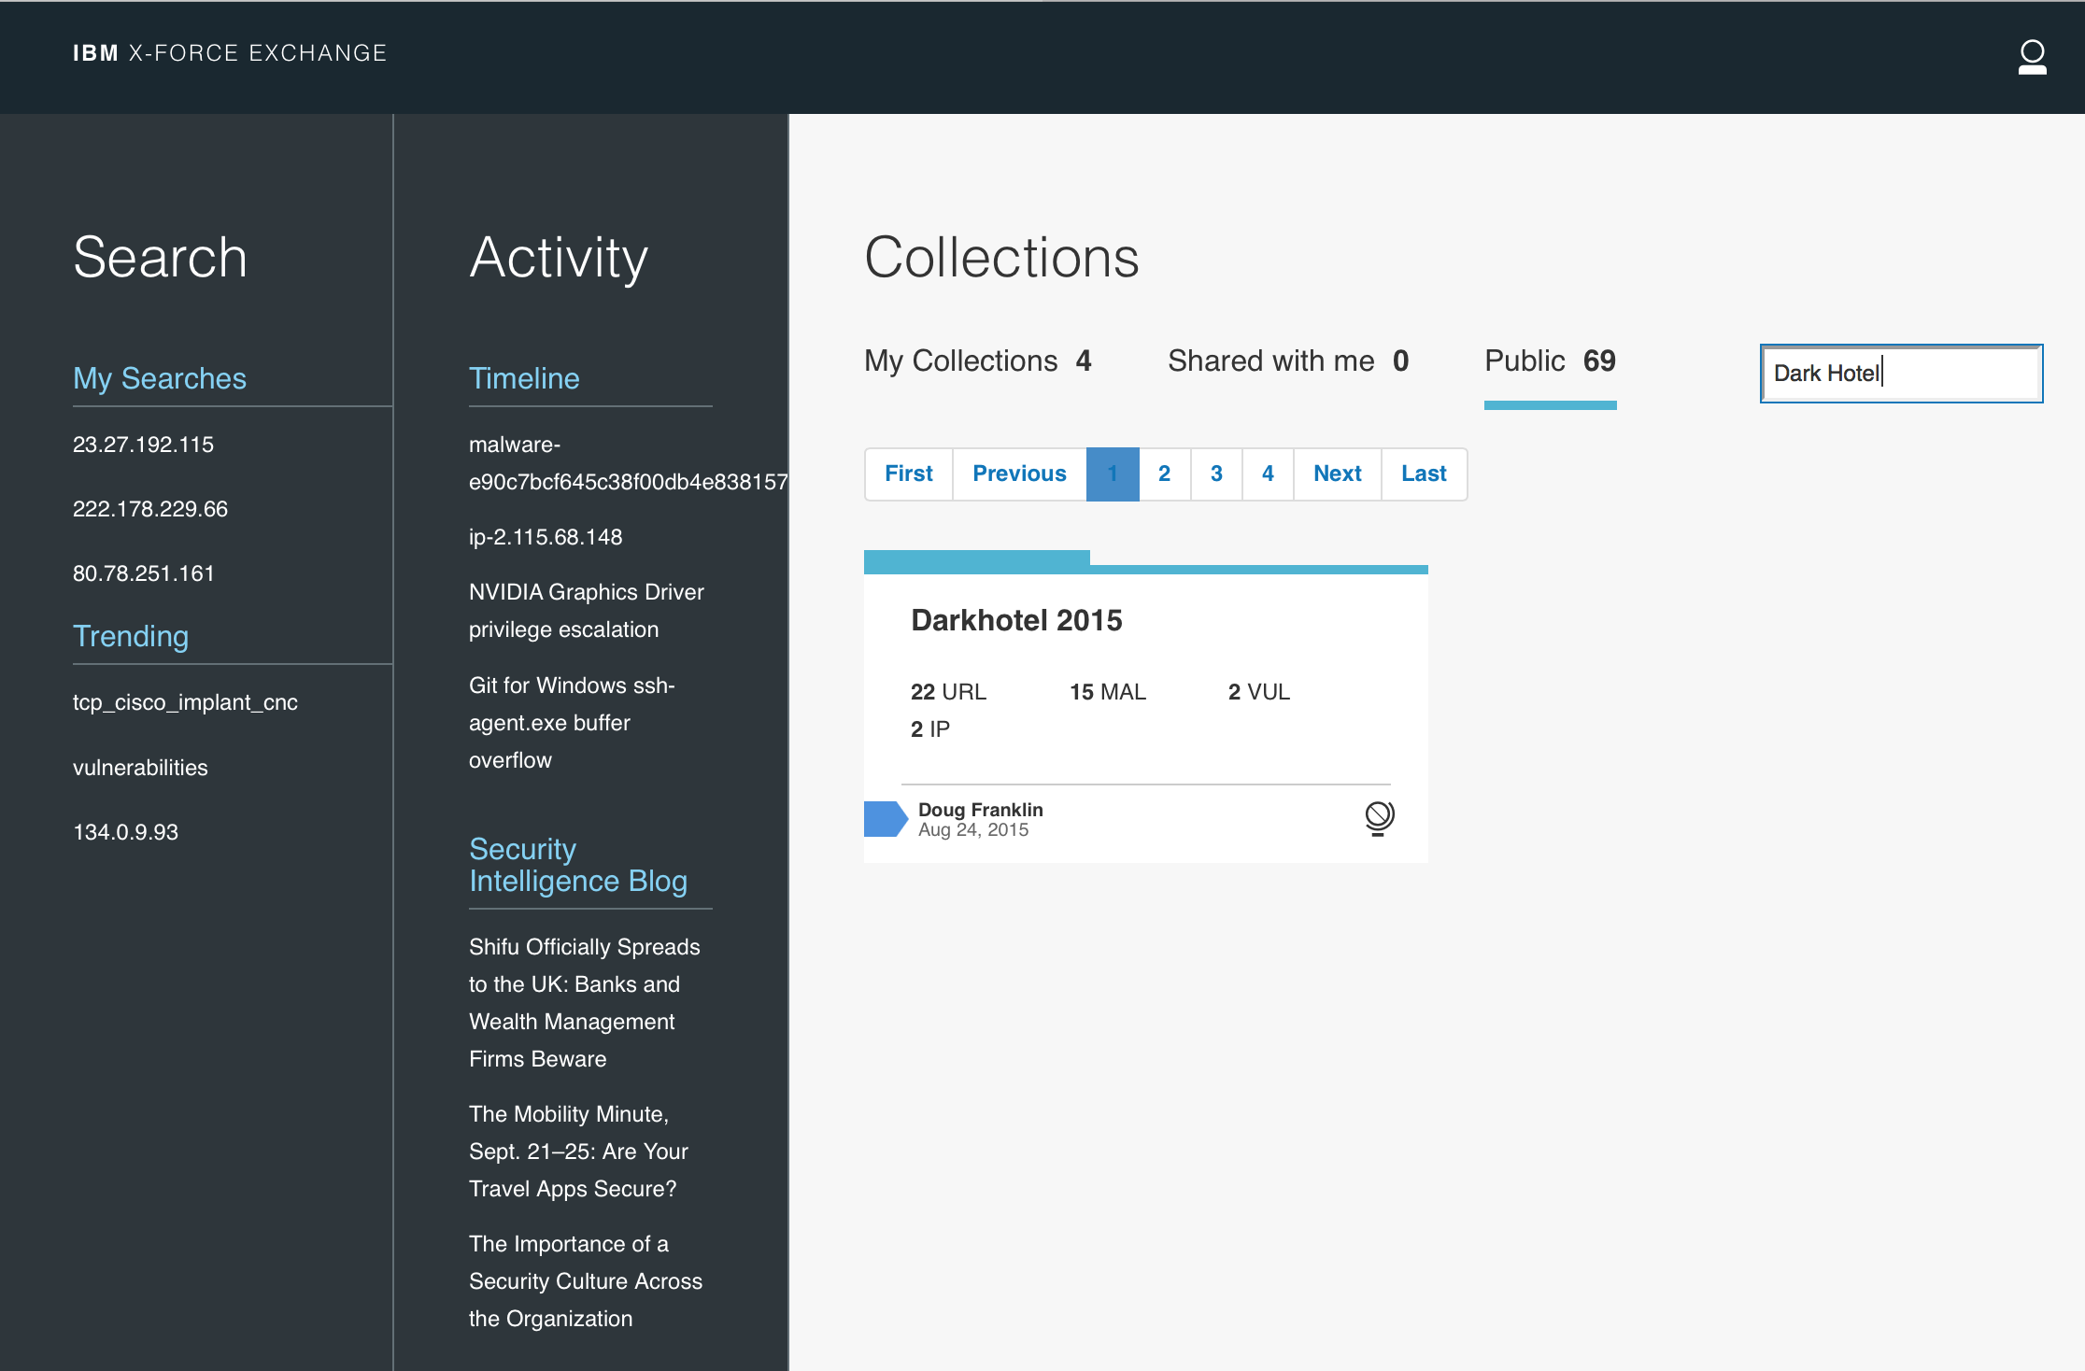

Slide 16
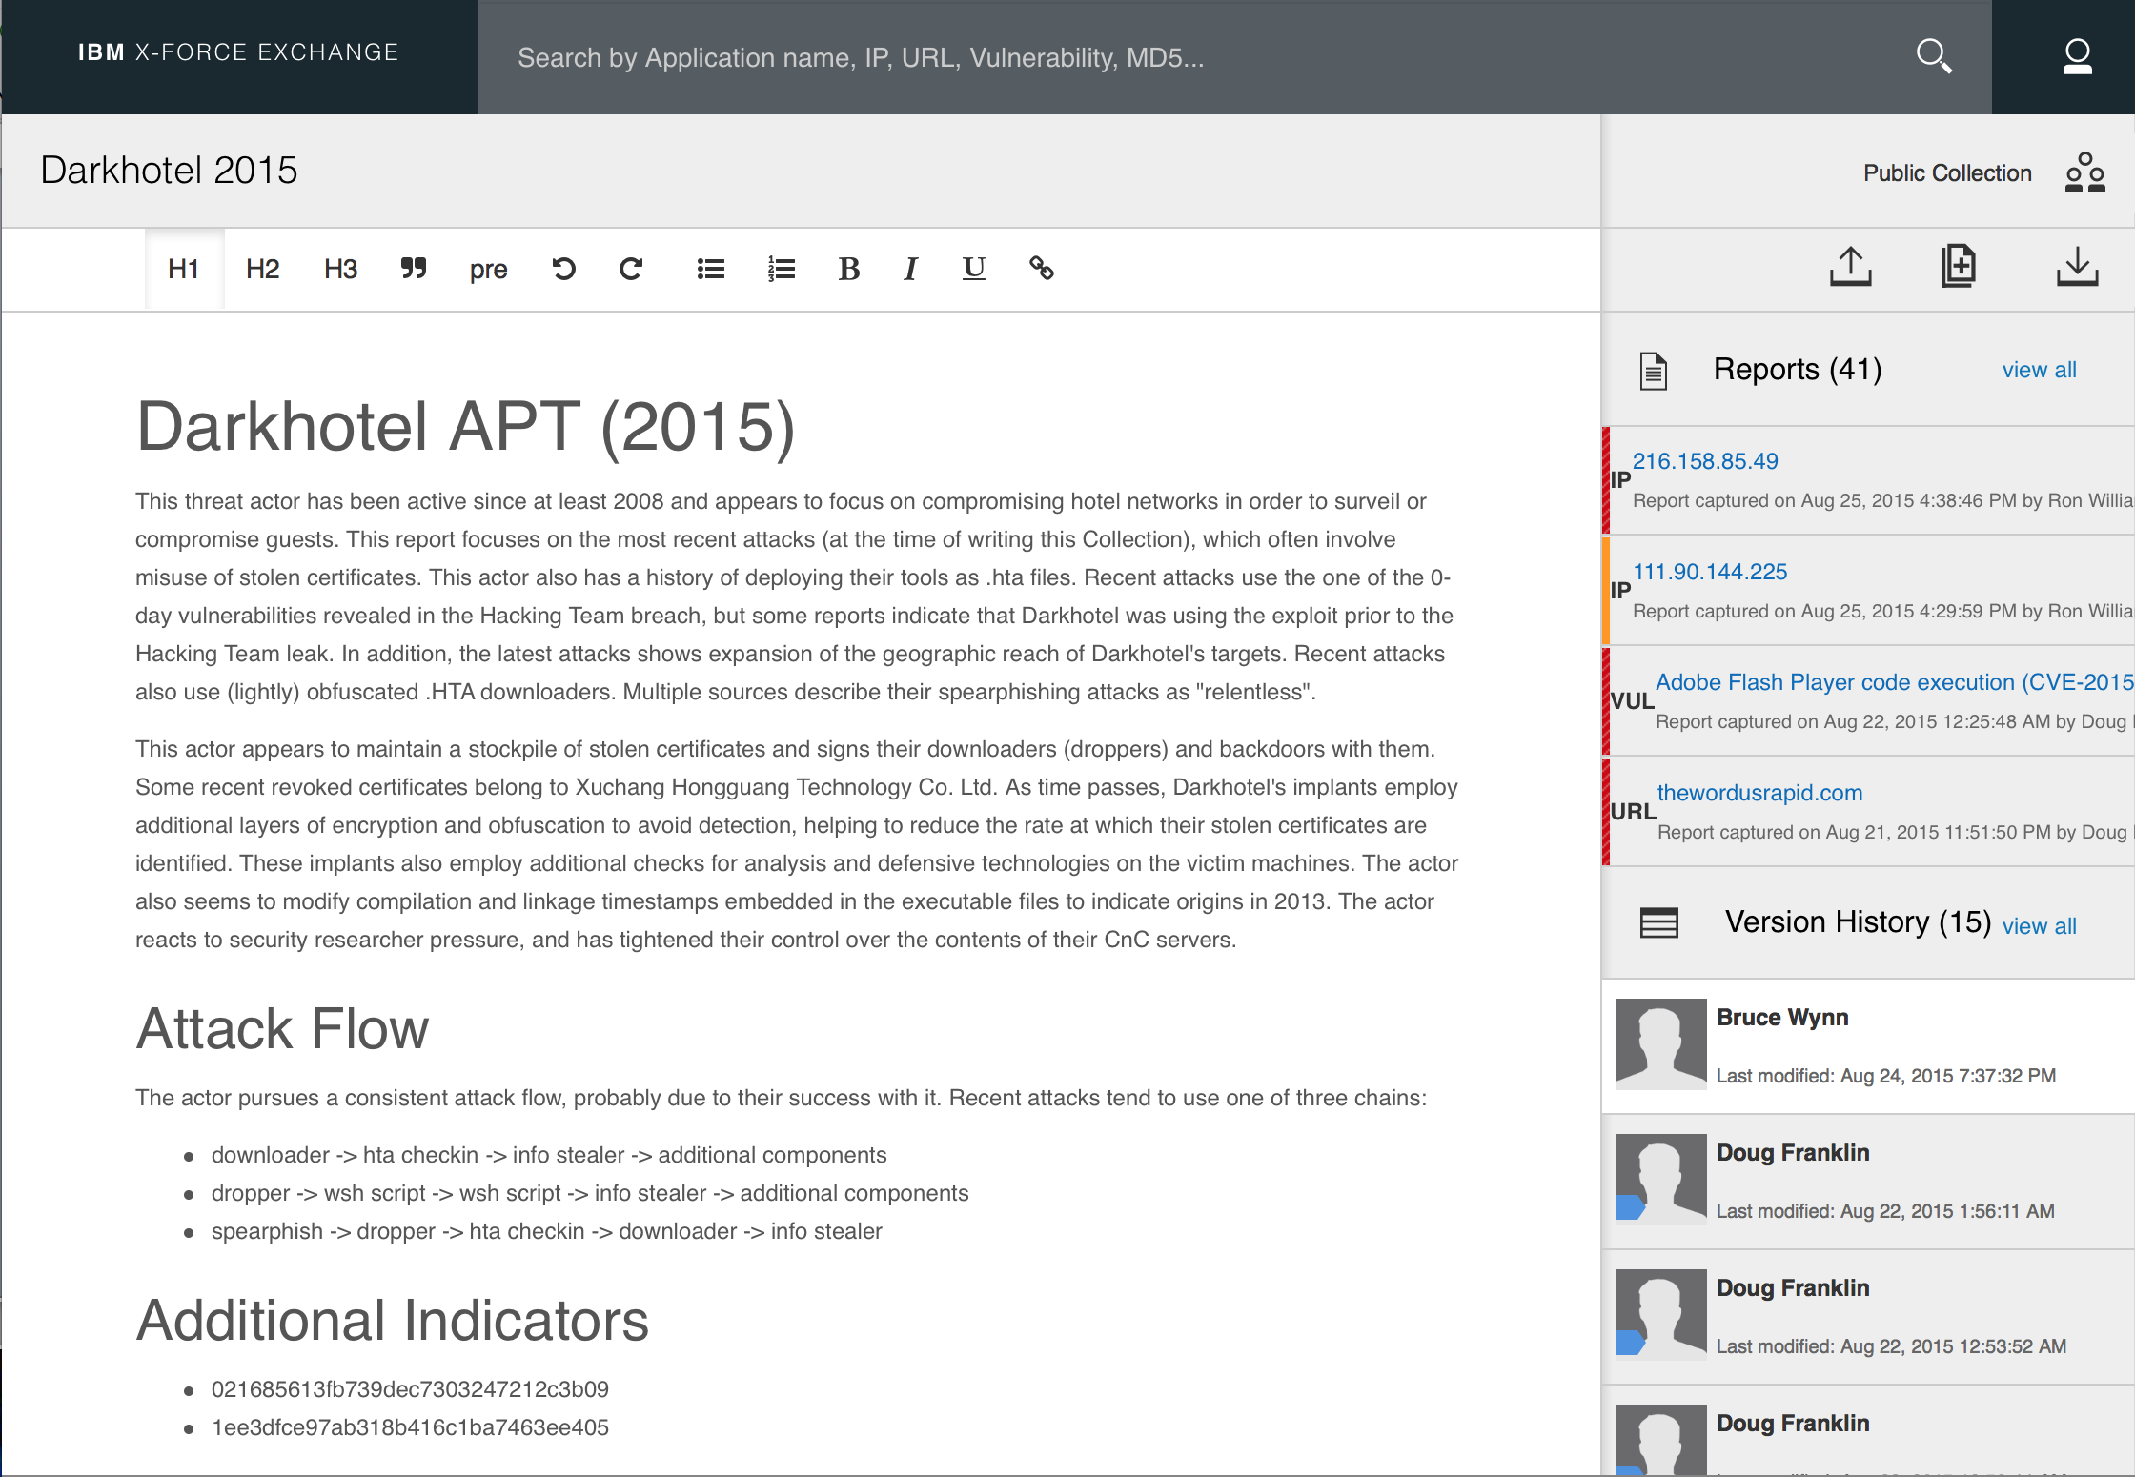

Slide 17
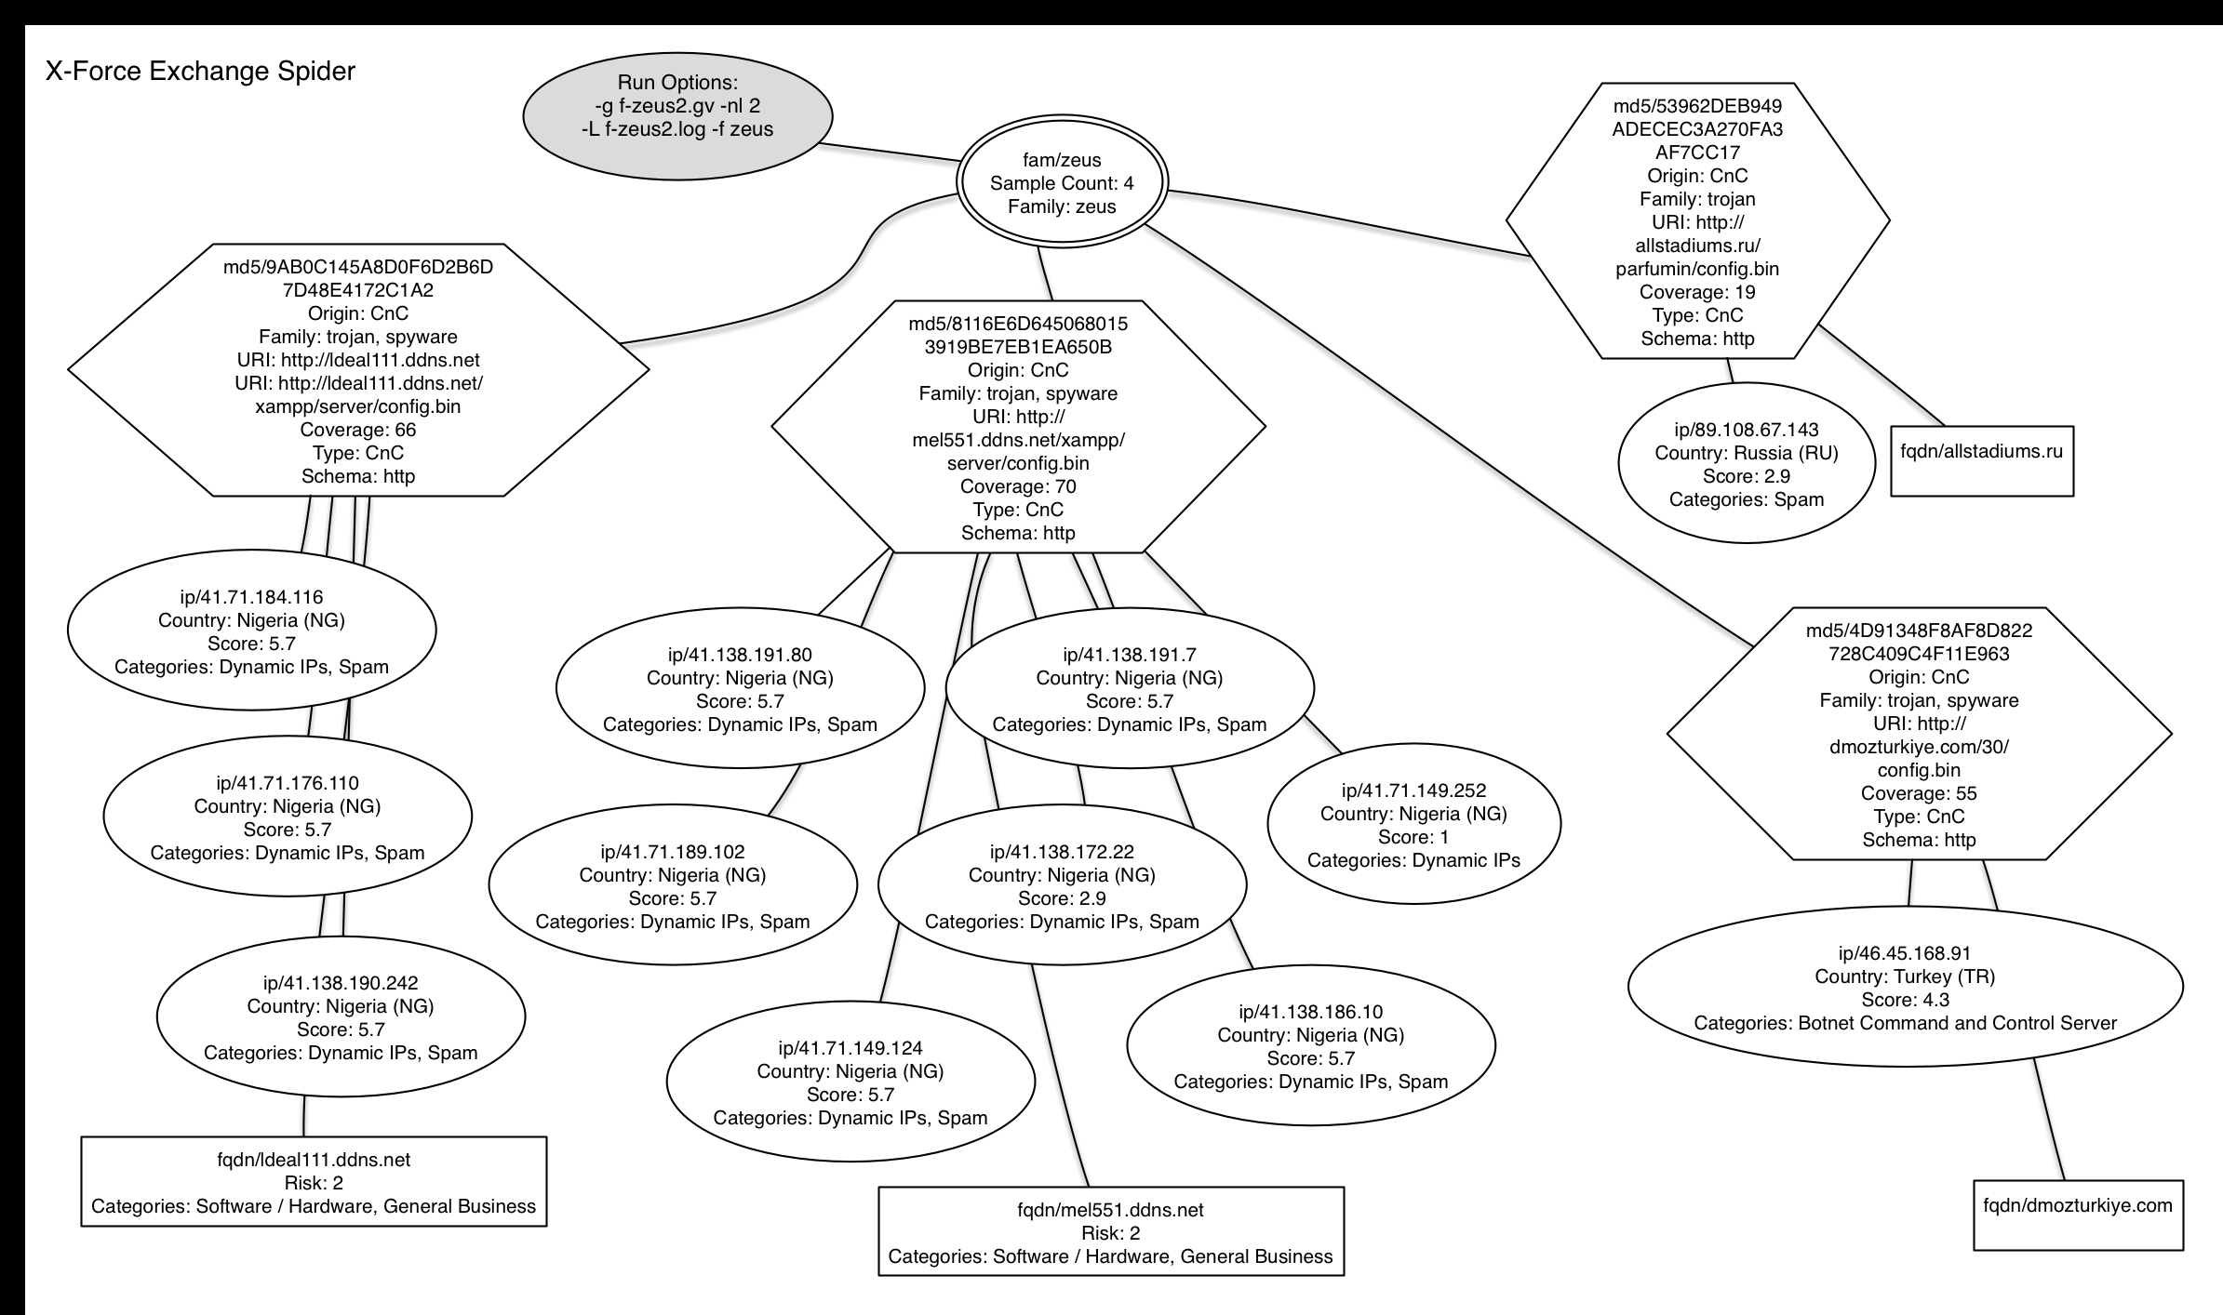
threat data -> intelligence

Slide 18
what we can share
Attack Flow
Suspect Internet IP’s & URLs
Identified Malware Signatures
Other IOC’s (Registry Keys, dropped files, command files, executables, etc.)
Meaningful Correlations
Significant data to assist the 2nd analyst

Slide 19
what we (typically) don’t share
internal infrastructure (internal networks, ip’s)
0day application and system vulnerabilities (unpublished)
target specific data (individuals, accounts, ip addrs, etc)

Slide 20
Threat Intelligence – Enabling Machine Processing
Making Threat Data and Intelligence Available
For the Human Analyst
For the Human Analysts Tools
Building and Threat Intelligence Ecosystem

Slide 21
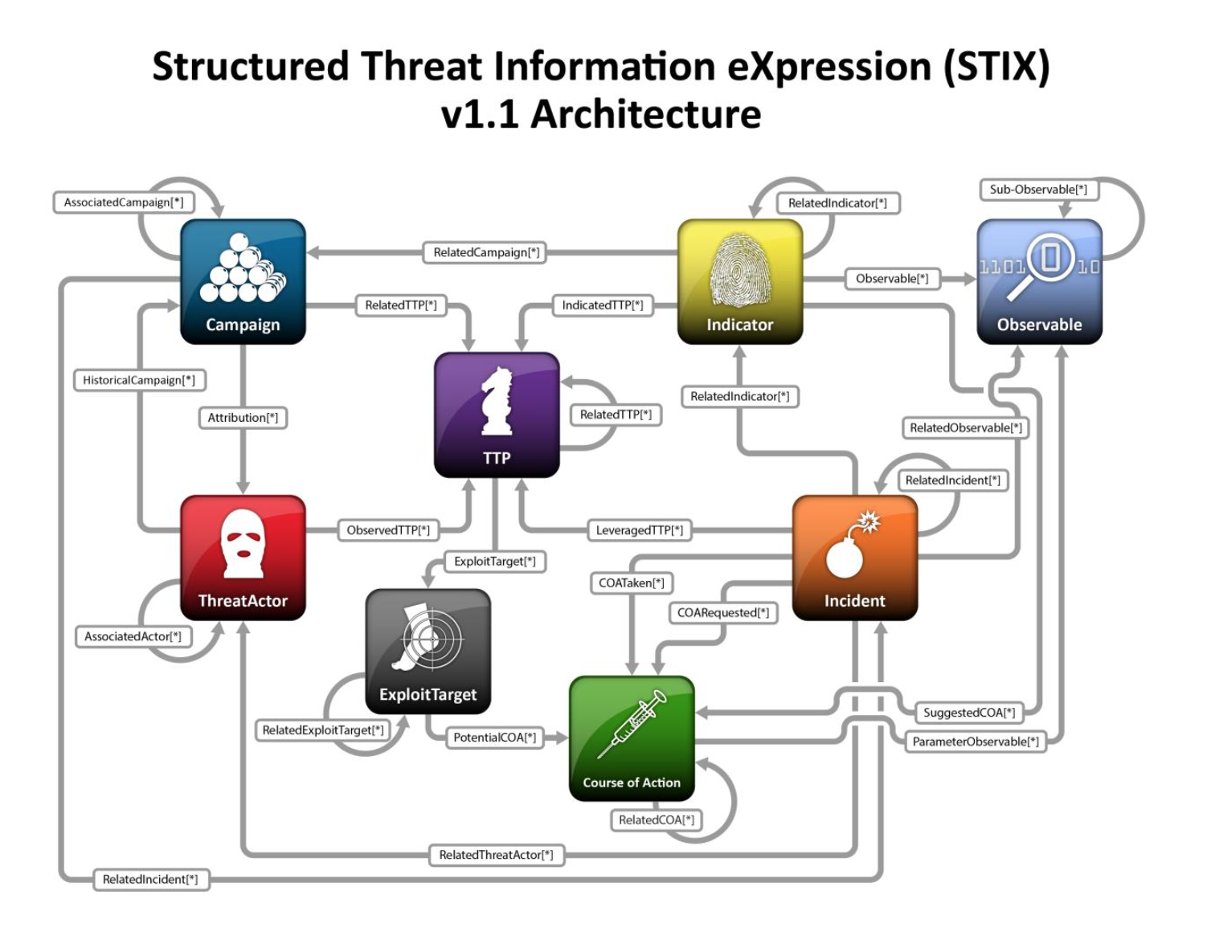

Slide 22
Accessing X-Force Exchange API
Public (free) Access
X-Force Exchange
https://exchange.xforce.ibmcloud.com
X-Force Exchange API
https://api.xforce.ibmcloud.com/doc

Slide 23
Who’s Using X-Force Exchange?
Threat Researchers – Aggregating IP, URL, Malware, and Vulnerability reports into Collections
Customers in Finance, Banking, Retail, and Energy
Managed Security Services Analysts – Using Collections to create report with historical threat information for operations.
3rd Party Developers building SDK’s to integrate X-Force Exchange Data with their own offerings (GitHub)

Slide 24
Accessing the API

Slide 25
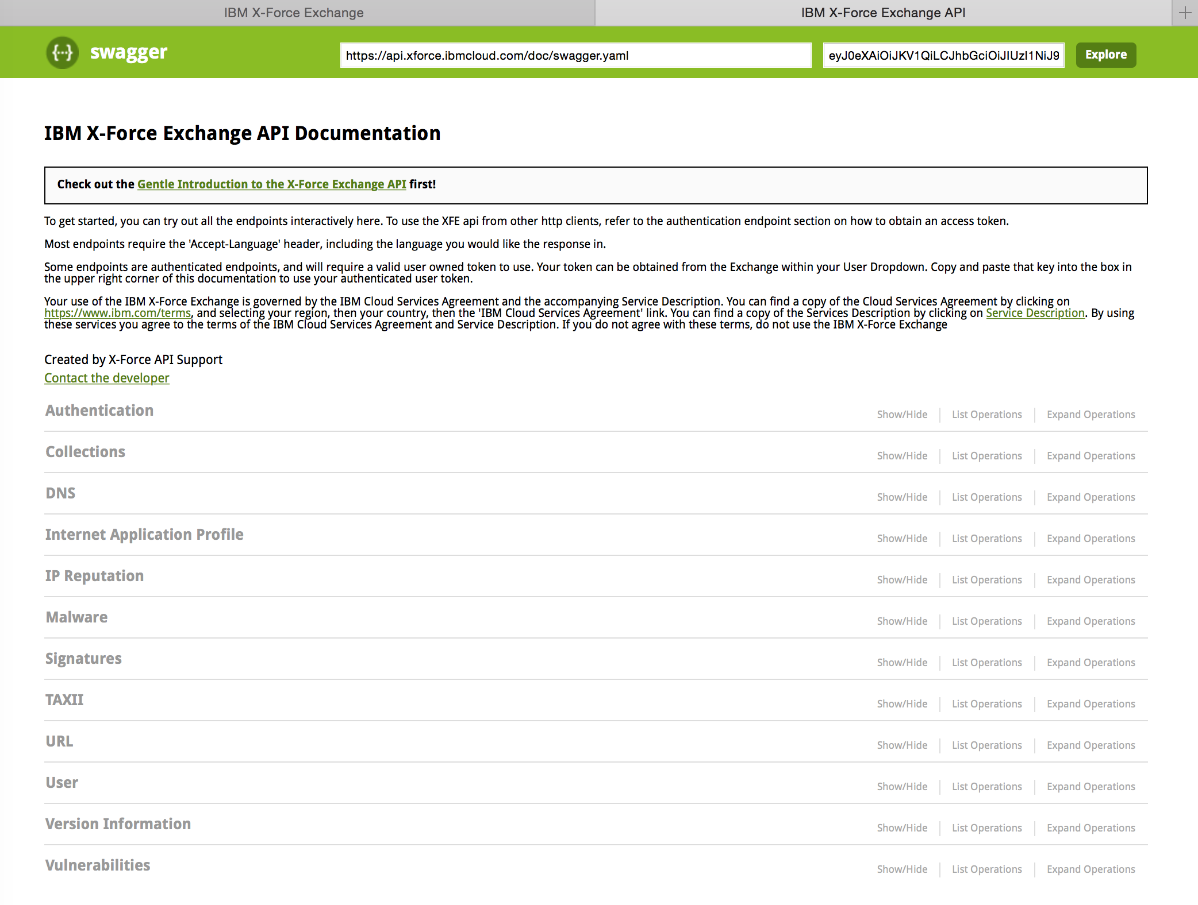

Slide 26
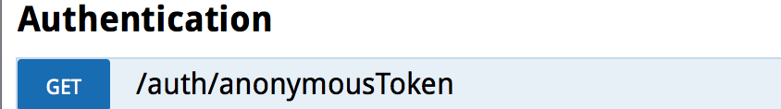
Request (curl)
curl -X GET --header "Accept: application/json”
"https://api.xforce.ibmcloud.com/auth/anonymousToken"
Response Body:
{
"token”: <jwt>
}
The <jwt> goes into Authorization Headers for subsequent
requests like this:
curl -X GET --header "Accept: application/json”
--header “Authorization: “Bearer <jwt>”

Slide 27

curl -X GET --header "Accept: application/json" --header "Authorization: Bearer <jwt>” https://api.xforce.ibmcloud.com/ipr/1.2.3.4"
Response (partial) in JSON Format
[ {
"ip": "1.2.3.4",
"cats": {
"Anonymisation Services": 43,
"Malware": 71,
"Botnet Command and Control Server": 71
},
"reason": "Content found on multihoster",
"created": "2015-06-16T09:48:00.000Z",
"score": 7.1,
"subnet": "1.2.3.4/32"
},
"cats": {
"Anonymisation Services": 43,
"Malware": 71,
"Botnet Command and Control Server": 71
},
"geo": {
"country": "Australia",
"countrycode": "AU"
},
"score": 7.1
}]

Slide 28
TAXII Interface (for STIX Formatted IP, URL, VULN, and User Collections)

Slide 29
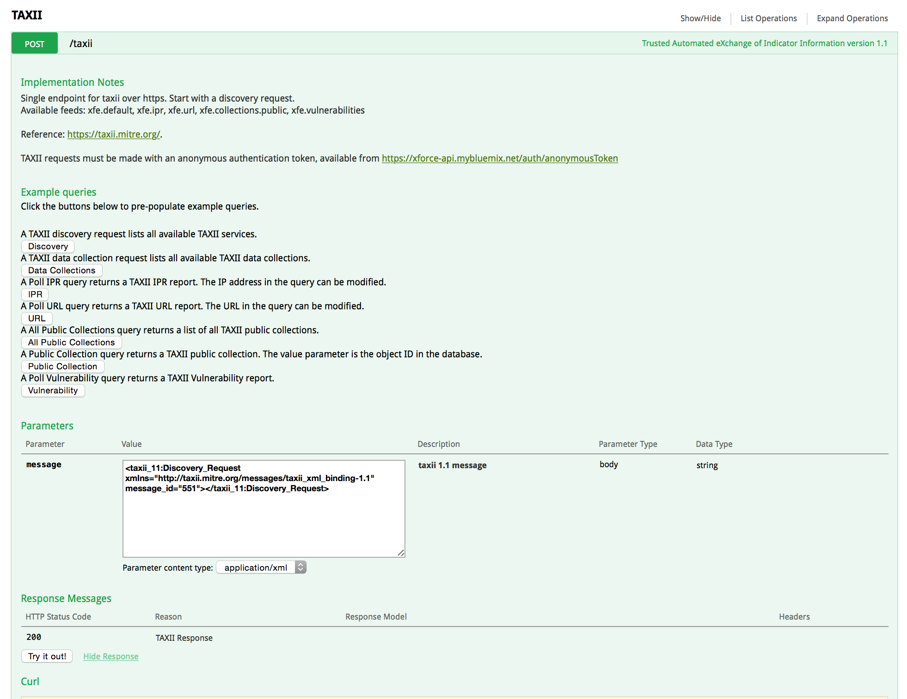

Slide 30
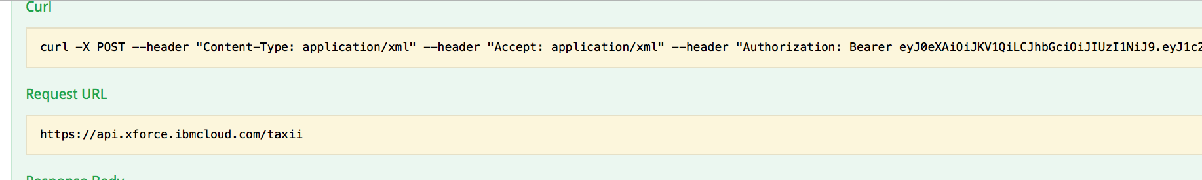
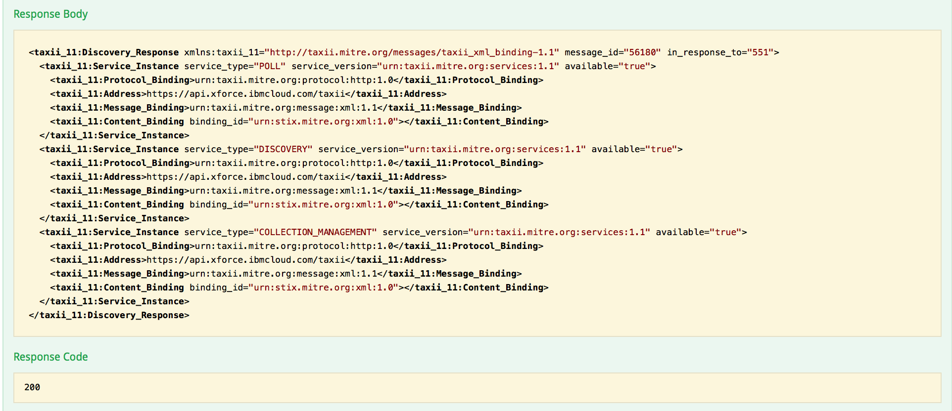

Slide 31
The Importance of Threat Intelligence Sharing
Research estimates indicate less than 20% of the IPv4 namespace is analyzed and categorized.
Increasingly, attacks use dynamic ip addresses and dynamically generated domain names to direct victims to command and control servers. This means that internet scanning and analysis by itself is not sufficient to protect against attack.
For IPv4 alone – there are over 4 billion possible endpoints. It is not possible to understand the state of all endpoints instantaneously. IPv6 renders random internet scanning a very low yield activity.
The ability to share active attack information with trusted colleagues and communities provides the most current information from which active attacks might be thwarted.

Slide 32
The Unthinkable or Unacceptable is not the same as the Impossible.
Plan for it - or it will plan for you.
– Anonymous

Slide 33

https://exchange.xforce.ibmcloud.com
ron williams, senior technical staff member
ibm security

